Slide 1



Department of Computer Science & Engineering
SPANDAN 2022
URJIT

Slide 2


PROJECT TITLE : GRANTH
VGI DIGITAL LIBRARY

Slide 3
OUR TEAM
ABHISHEK KUMAR
B.TECH CSE BATCH 2020-2024
TEAM GRANTH -VGI DIGITAL LIBRARY
ANIKET SRIVASTAVA
B.TECH CSE BATCH 2020-2024
Under the guidance of
Mrs. Madhu Lata Nirmal (HOD, CSE)
Mr. Manoj Rajora (PROJECT TRAINER, CSE)
MOHAMMAD SHAFAQUE
B.TECH CSE BATCH 2020-2024

Slide 4

ABSTRACTION
“Granth” is the digitalization of existing library system. It is aimed to automate the existing system of manually working processes and to manage several important activities of library in a digital mode. It is designed to manage and track the daily work of the library such as issue books, return books, maintain student details, due calculation, catalogue, and book search etc.

Slide 5
problem & solution
PROBLEM STATEMENT :
Existing library system is not a digitalized system and so involves a lot of paperwork.
There is a need to visit library for any small or big work and so we end up wasting a lot of time to keep checking if library is open or not and librarian is available or not.
It is not easy to know if there is any fine imposed unless you visit library physically.
It is not possible to see any published notice until you visit the notice board of the library.
User does not have data regarding books issued from library or returned to library.
SOLUTION STATEMENT :
GRANTH will be the solution of all such problem cases.

Slide 6
SOME KEY FEAUTURES OF GRANTH – VGI DIGITAL LIBRARY :
You can access it from anywhere, anytime.
No need to visit library every time.
User can see available books over his/her dashboard.
Student and faculties can request books from anywhere anytime.
Student can update his/her profile.
Librarian will update about your requested book through Email and will share the time between which you can collect your book.
Librarian can manage Books, Different Categories, Authors, Notices.
Librarian can manage registered students – He can make any student inactive if he or she is not following the proper code of conduct.
Librarian can resolve complaints raised by users.
Librarian can inform user about fine if any.

Slide 7



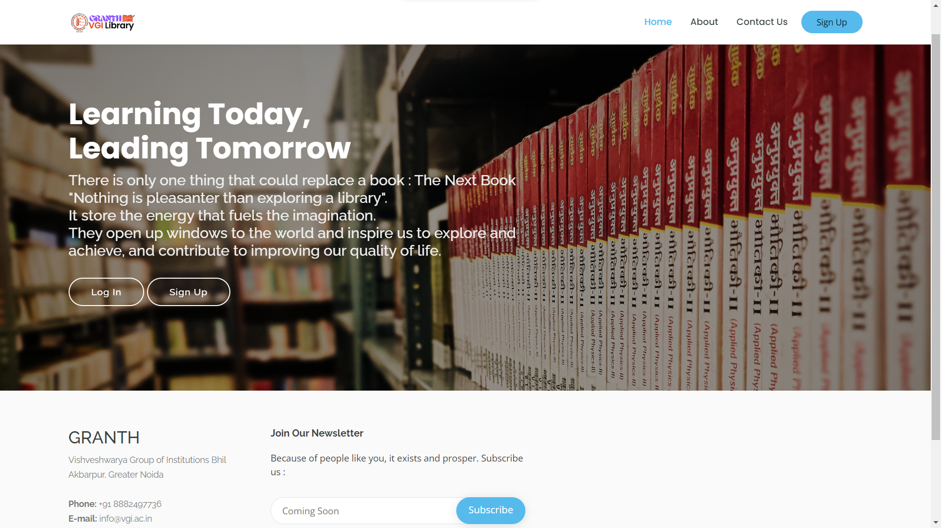
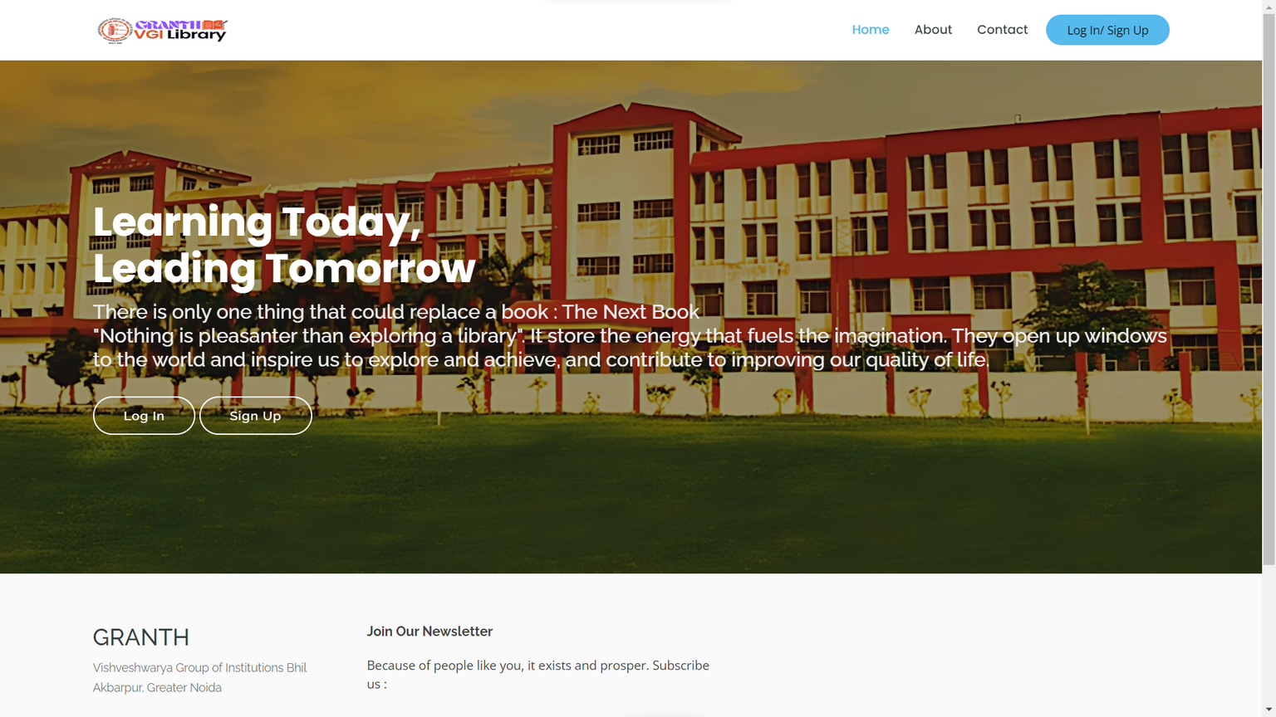
HOMEPAGE
Homepage contains About Page, Contact Page, LogIn, SignUp options

Slide 8
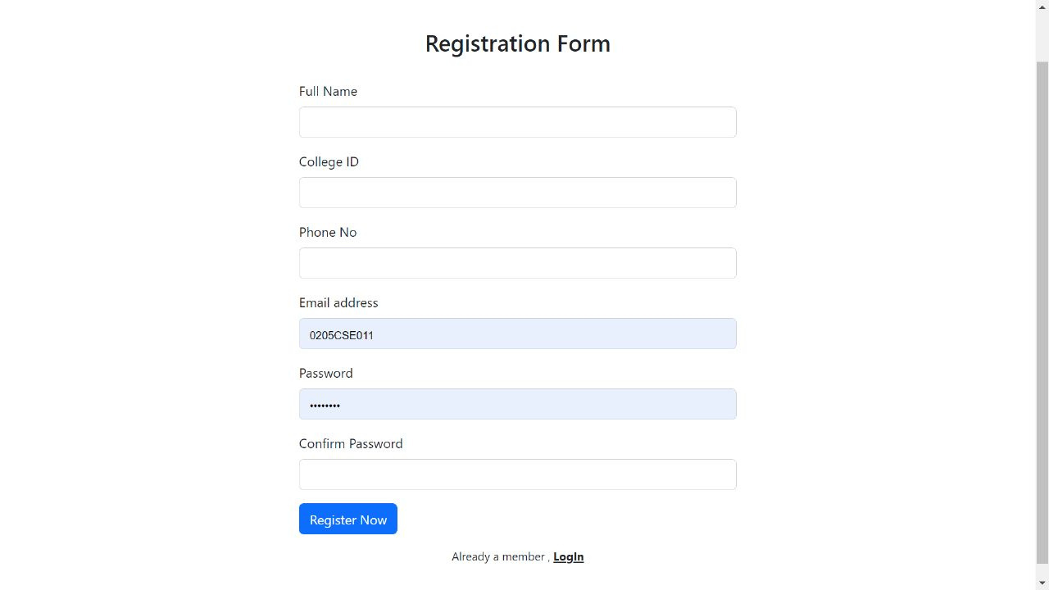
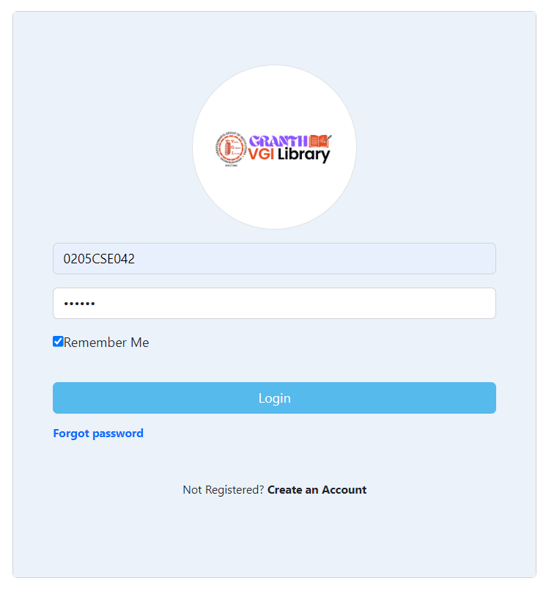
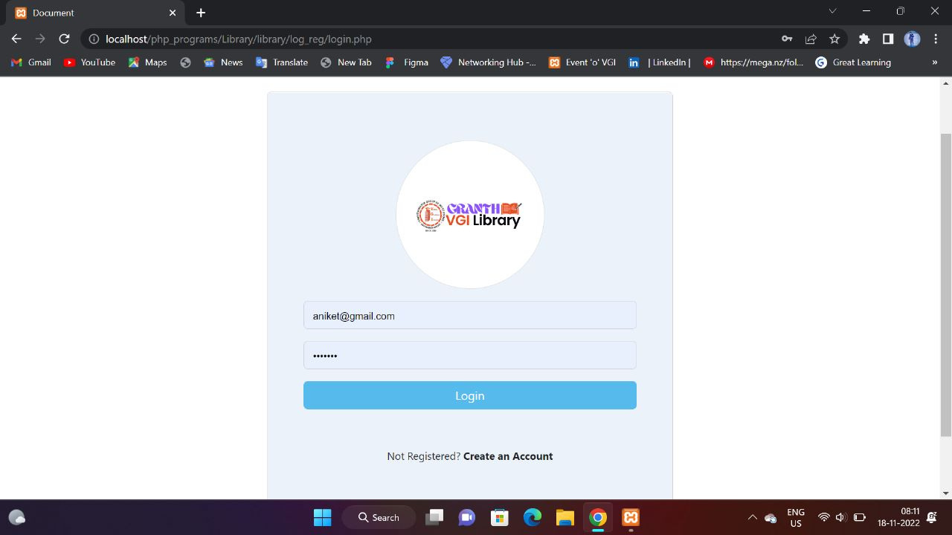
SIGNUP & LOGIN

Slide 9
USER LOGIN PAGE.
NEW USER OR STUDENT REGISTRATION.
REQUEST BOOKS.
SEARCH AVAILABLE BOOKS.
VIEW ISSUED BOOK DATA.
MANAGE PROFILE.
RAISE COMPLAINT AND GIVE FEEDBACK.
SEE ALL NOTICES
DATA OF ALL ISSUED AND RETURNED BOOKS
USER MODULE

Slide 10
MANAGE BOOK RECORDS
MANAGE REGISTER USER RECORDS
ENABLE OR DISABLE REGISTER USER LOGIN
ISSUE BOOK
RETURNED BOOK
ADD NOTICES
CALCULATE FINE ON LATE
MANAGE CATEGORY DATA
MANAGE AUTHORS DATA
MANAGE LOCATION RACK DATA
DYNAMICALLY CONFIGURED LIBRARY SYSTEM
ADMIN LOGIN PAGE
ADMIN CHANGE PASSWORD
ISSUED BOOK CONFIRMATION BY EMAIL
ADMIN MODULE

Slide 11
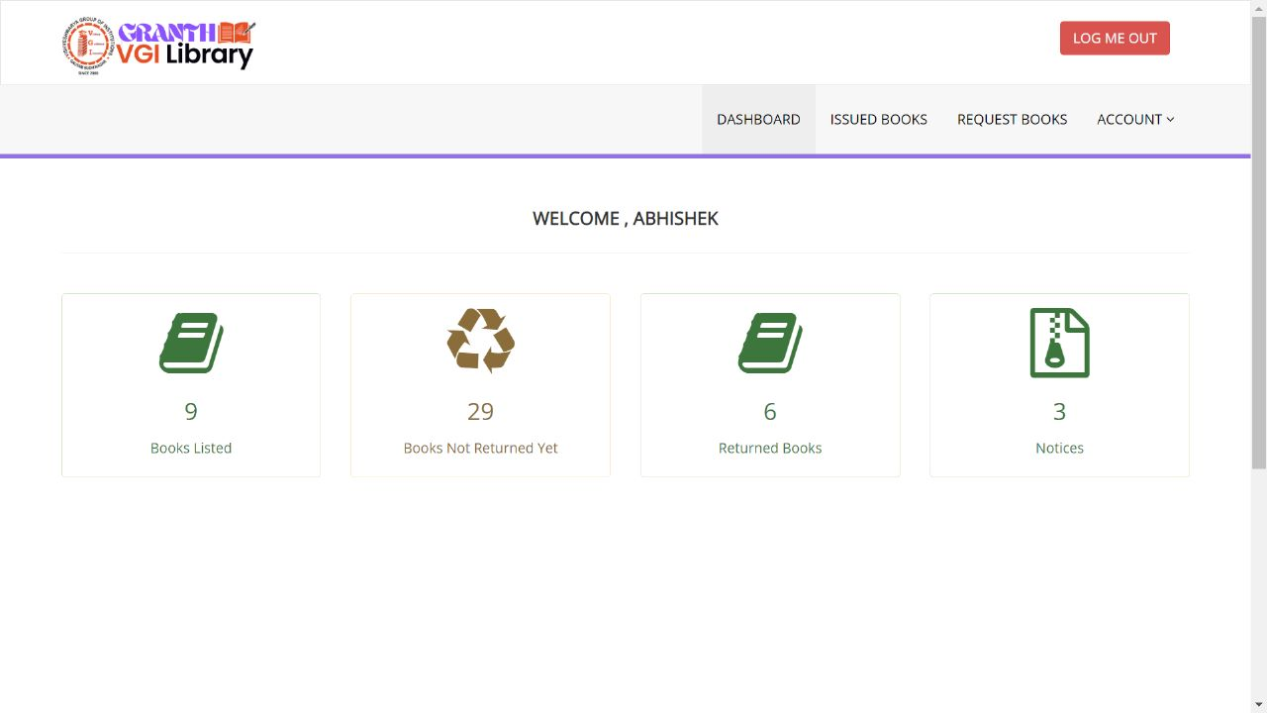
USER DASHBOARD

Slide 12
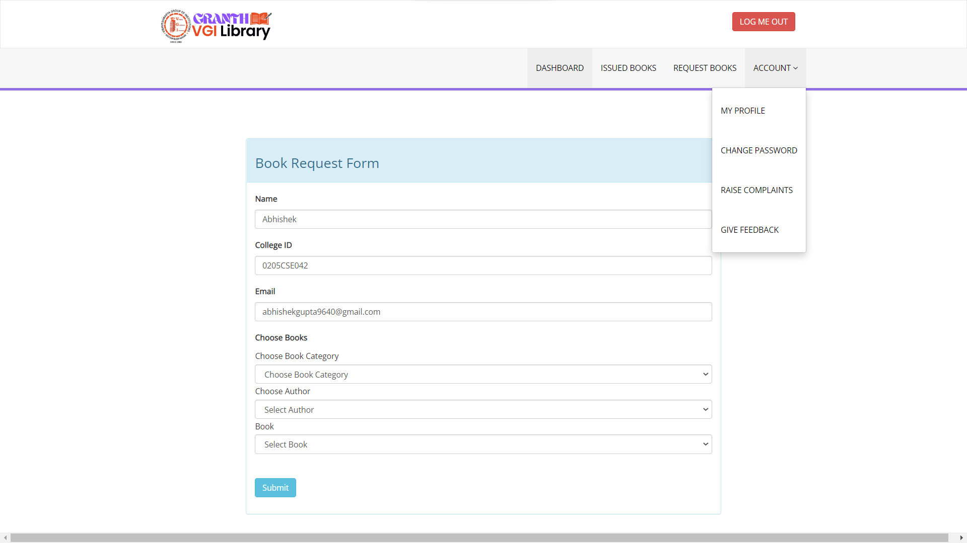
BOOK REQUEST FORM

Slide 13
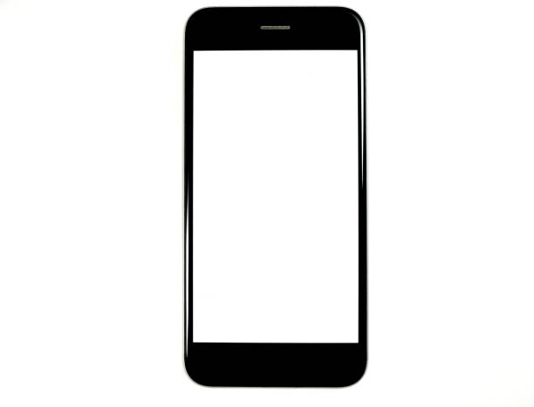
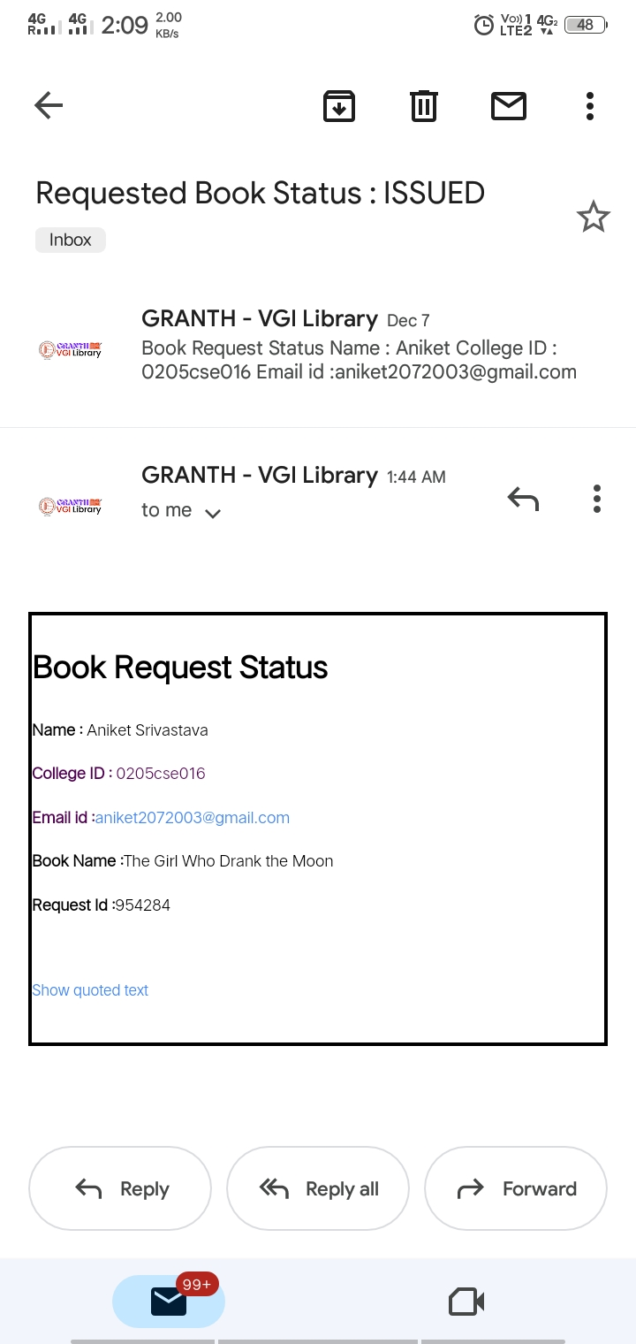
EMAIL CONFIRMATION OF ISSUED AND REJECTED REQUEST OF BOOKS
INFORM ABOUT
LIBRARIAN CAN APPROVE OR REJECT THE BOOK REQUESTED BY STUDENTS

Slide 14
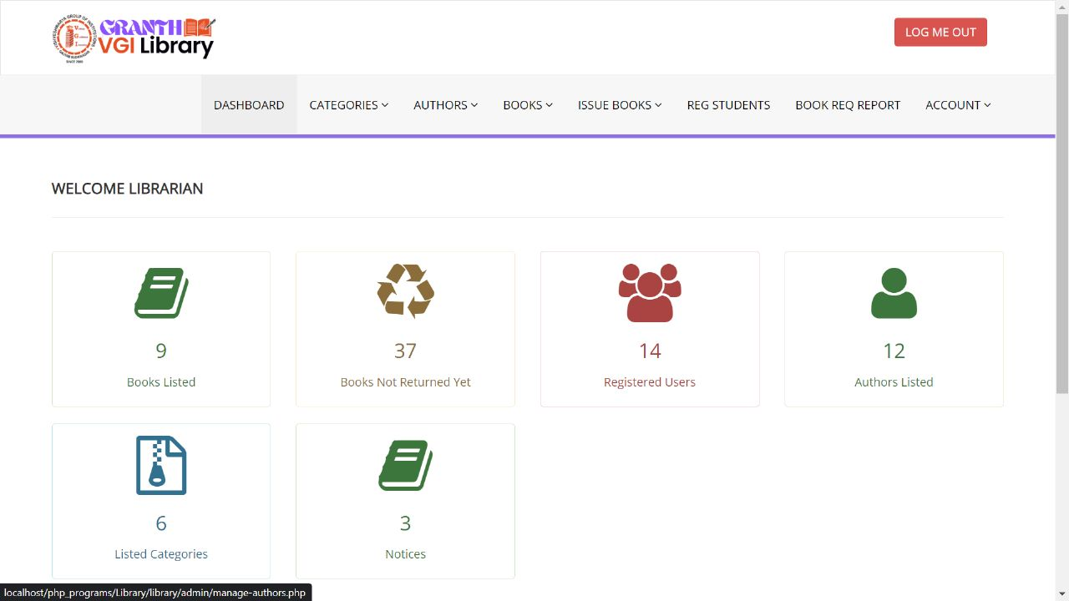
ADMIN DASHBOARD

Slide 15
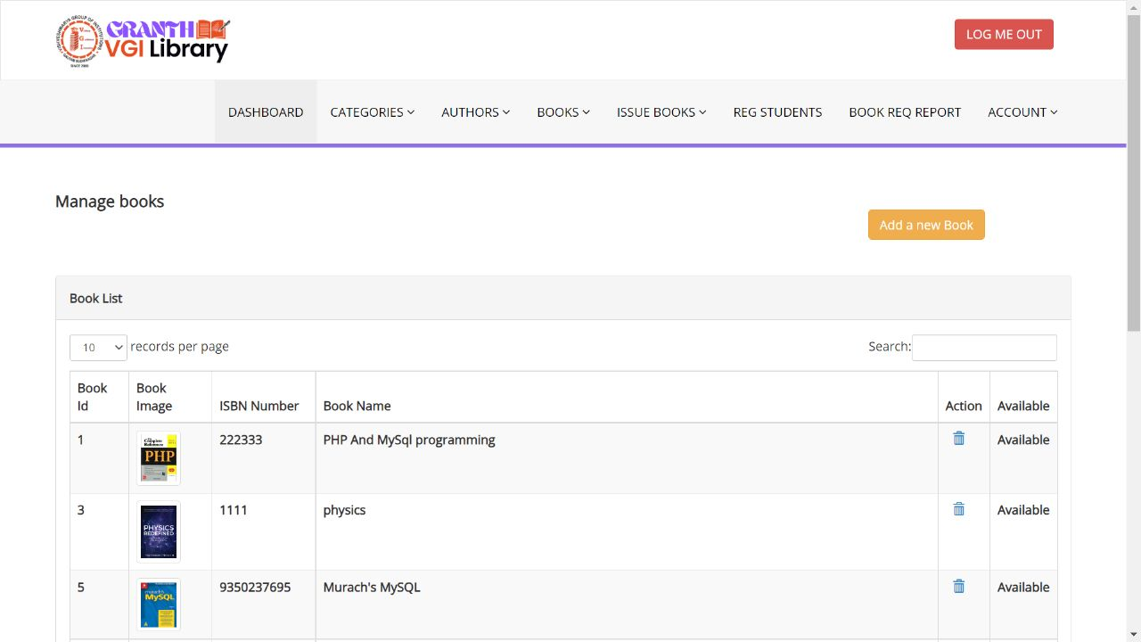
LIST OF BOOKS

Slide 16
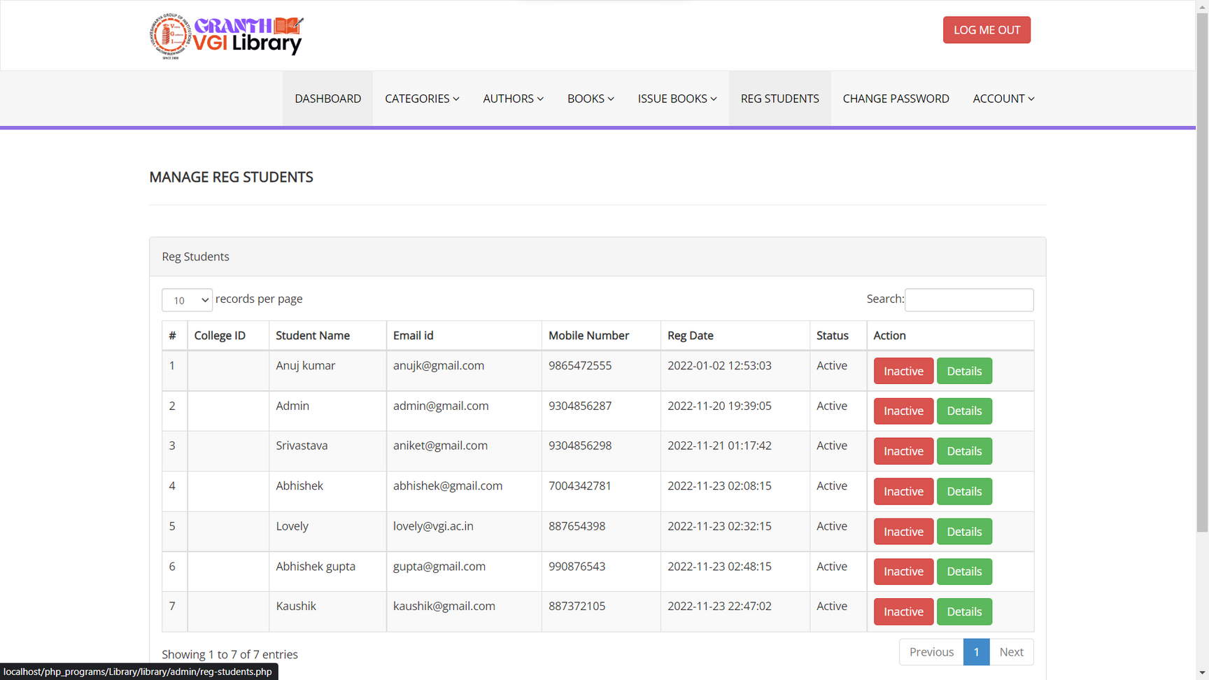
STUDENT LIST

Slide 17
FEAUTURES WE WILL ADD FURTHER
LIBRARIAN CAN SHARE E-CONTENT WHICH IS VISIBLE TO STUDENT AS WELL AS FACULTIES.
USER AND ADMIN CAN READ AND SHARE ARTICLES AVAILABLE OVER OUR WEBSITE.
ADMIN CAN INFORM ABOUT UPCOMING NEW BOOKS/ARTICLES/JOURNALS.
ADMIN CAN SEND WARNING MESSAGE TO USER REGARDING FINE THROUGH EMAIL ALSO.

Slide 18
THANK YOU EVERYBODY!
REGARDS
TEAM GRANTH - VGI DIGITAL LIBRARY

